Slide 1
Global Life Expectancy, Poverty and Literacy
An analysis of WHO Regional Data
Carla King, Data Analytics Capstone Project
September 14, 2020

Slide 2
Introduction
Strong interest in global health, particularly social determinants such as economic status, education, and gender
World Health Organization (WHO) periodically collects country level data on social determinants of health
Indicators include:
Access to healthcare, vaccination rates
Political stability, economic status
Literacy and education
Important to understand how indicators are correlated and critical determinants that would significantly impact the country’s health
Allows WHO to focus funding on appropriate programming
Address issues within own country and identify vulnerable populations

Slide 3
Project Goals
Research Objective
To understand the relationship between WHO indicators and social determinants of health globally
Outcome measures
Life expectancy
Maternal Mortality
Predictors
WHO region
Income Group/Poverty
Literacy, education
Inequality/democracy scores
Technical Skills
Practice cleaning a large dataset with many variables
Correlations and linear regressions in Python and Tableau

Slide 4
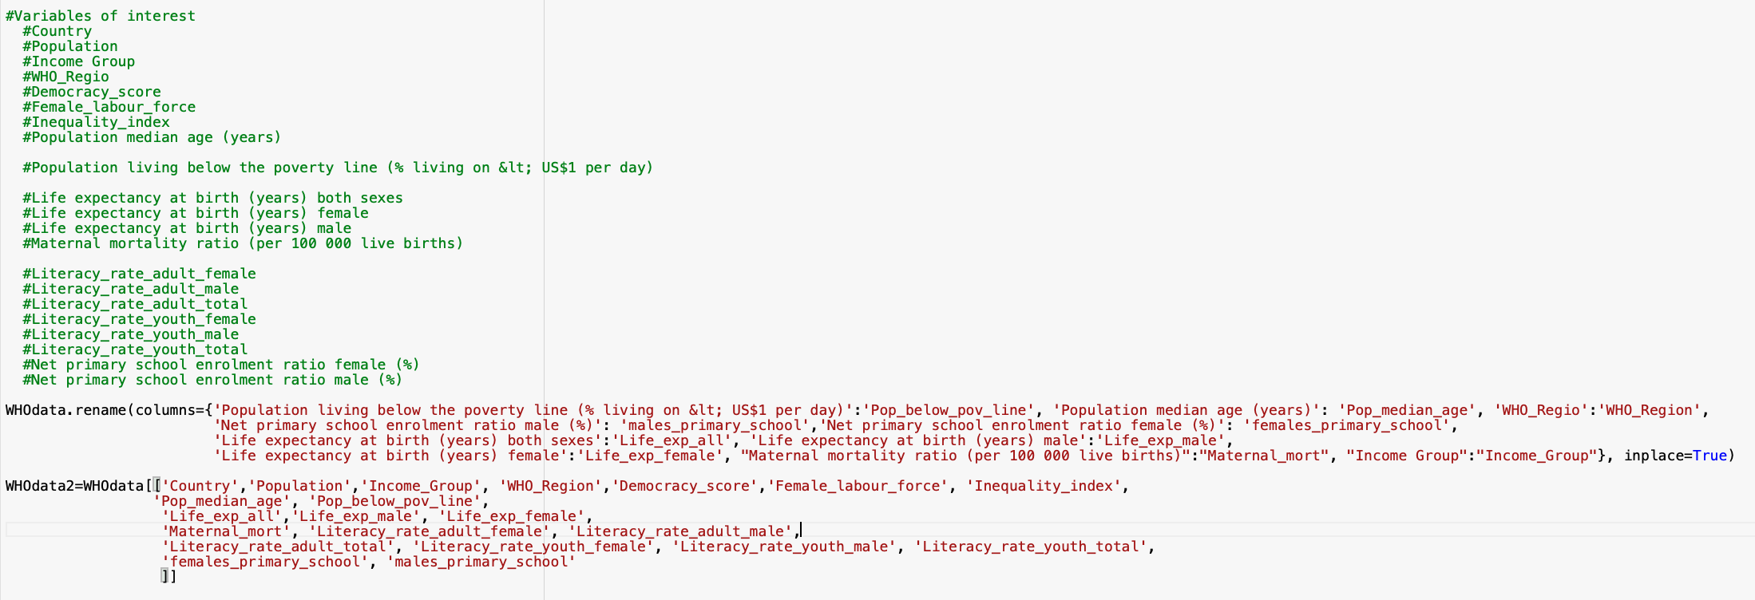
Methodology
Data Sources
WHO indicators from all WHO countries
WHO list of regions
Python
Merge datasets (by country)
Rename columns
Critical for correlations (need variables without spaces)
Determine and create dataset with variables of interest
Organize correlations and regression analyses based on research aims

Slide 5
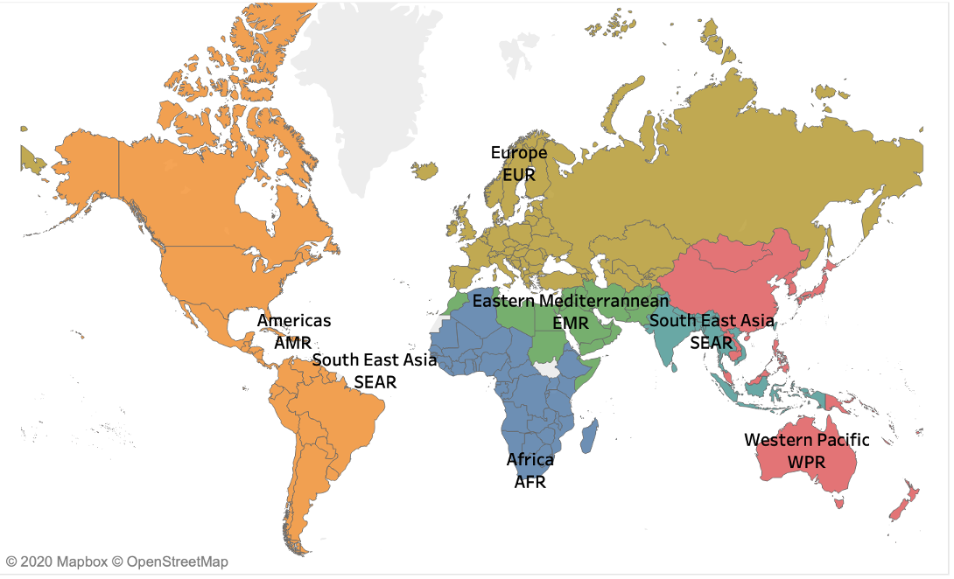
Relevant Indicators
WHO Regions
Africa (AFR)
Americas (AMR)
Eastern Mediterranean (EMR)
Europe (EUR)
South East Asia (SEAR)
Western Pacific (WPR)
Life Expectancy
Age (years) expected at birth
Maternal Mortality
Deaths per 100,000 live births
Population Below Poverty Line
% of population that lives with <$1USD per day
Female Literacy
% of adult female population deemed literate

Slide 6
Research Question
Overall Research Question: How do poverty and education/literacy relate to life expectancy?
Specific Questions:
Does poverty predict life expectancy?
Are life expectancy and maternal mortality correlated?
Do female education/literacy predict female workforce?
Do female education/literacy/workforce predict maternal mortality rates?
Does democracy predict education/literacy?

Slide 7
Results

Slide 8
Summary Statistics
WHO Region | Life Expectancy | Maternal Mortality | Population Below Poverty Line (%) | Female Literacy
AFR | 52.93 | 809.65 | 35.8 | 53.4
AMR | 72.37 | 143.24 | 13.4 | 86.2
EMR | 67.28 | 312.66 | 6.0 | 66.6
EUR | 75.07 | 27.37 | 2.5 | 96.6
SEAR | 66.72 | 355.27 | 19.1 | 70.8
WPR | 69.96 | 182.06 | 25.7 | 78.7

Slide 9
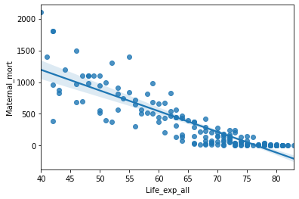
Life Expectancy and Maternal Mortality
Strong, negative correlation (correlation coefficient=-.87)
Both can be used as good predictors of mortality

Slide 10
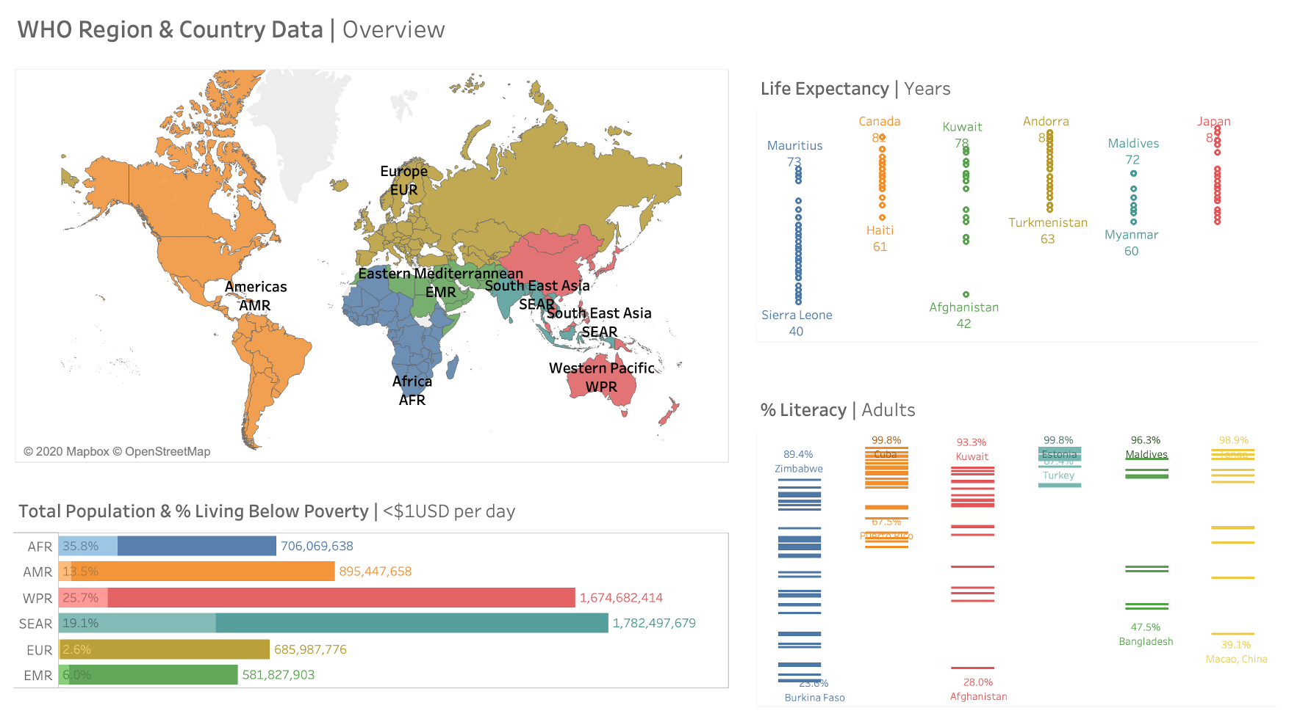

Slide 11
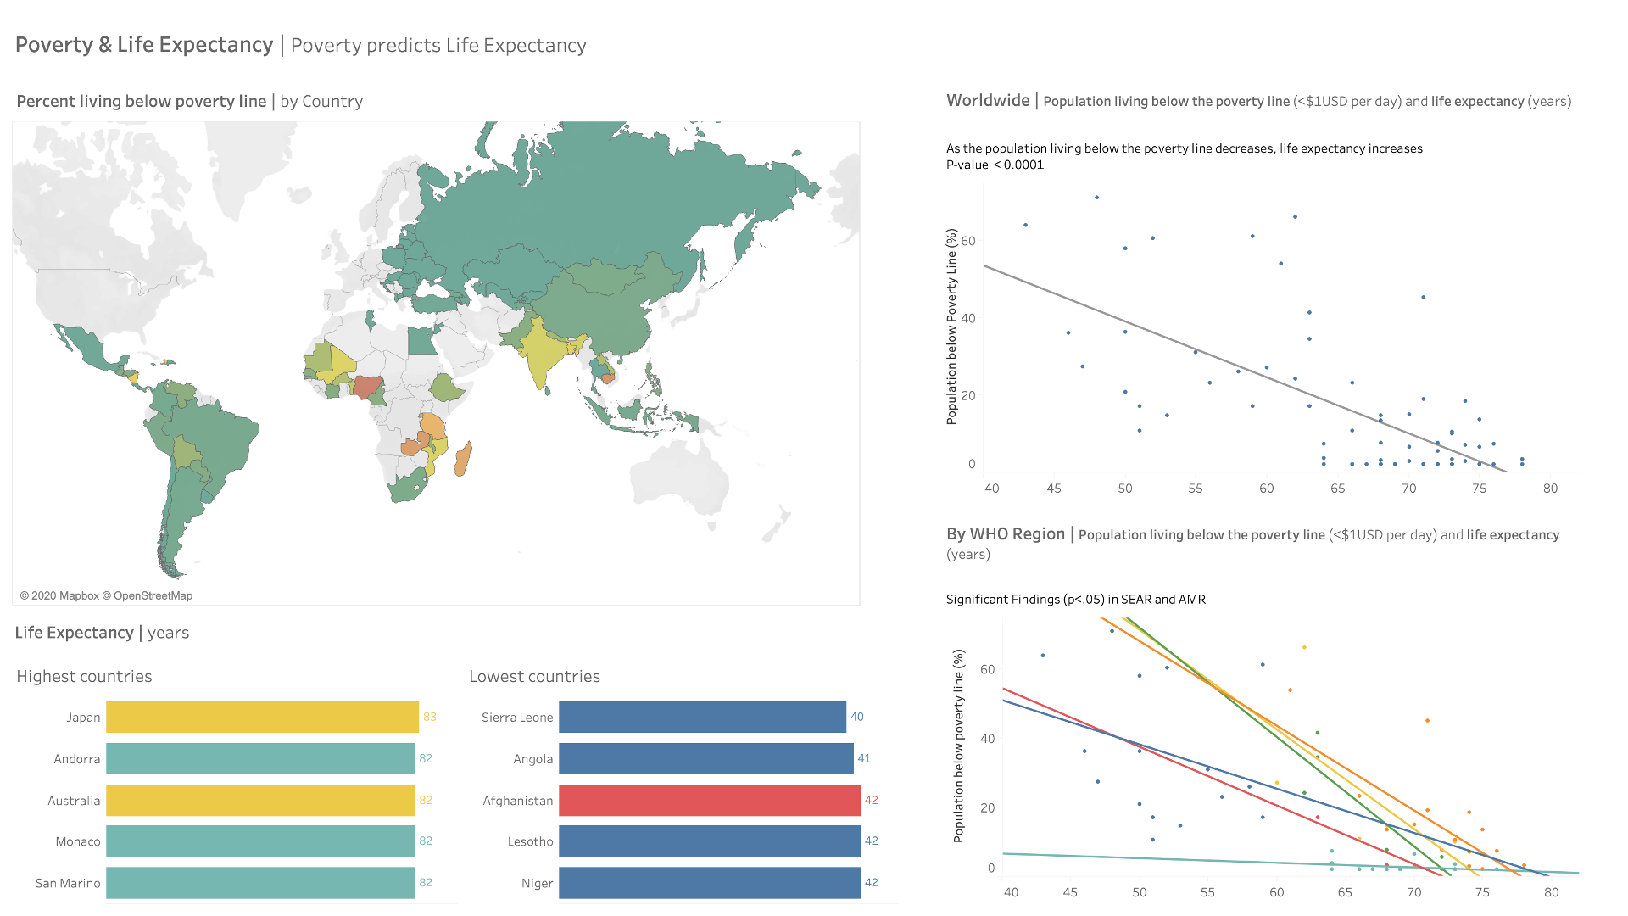

Slide 12
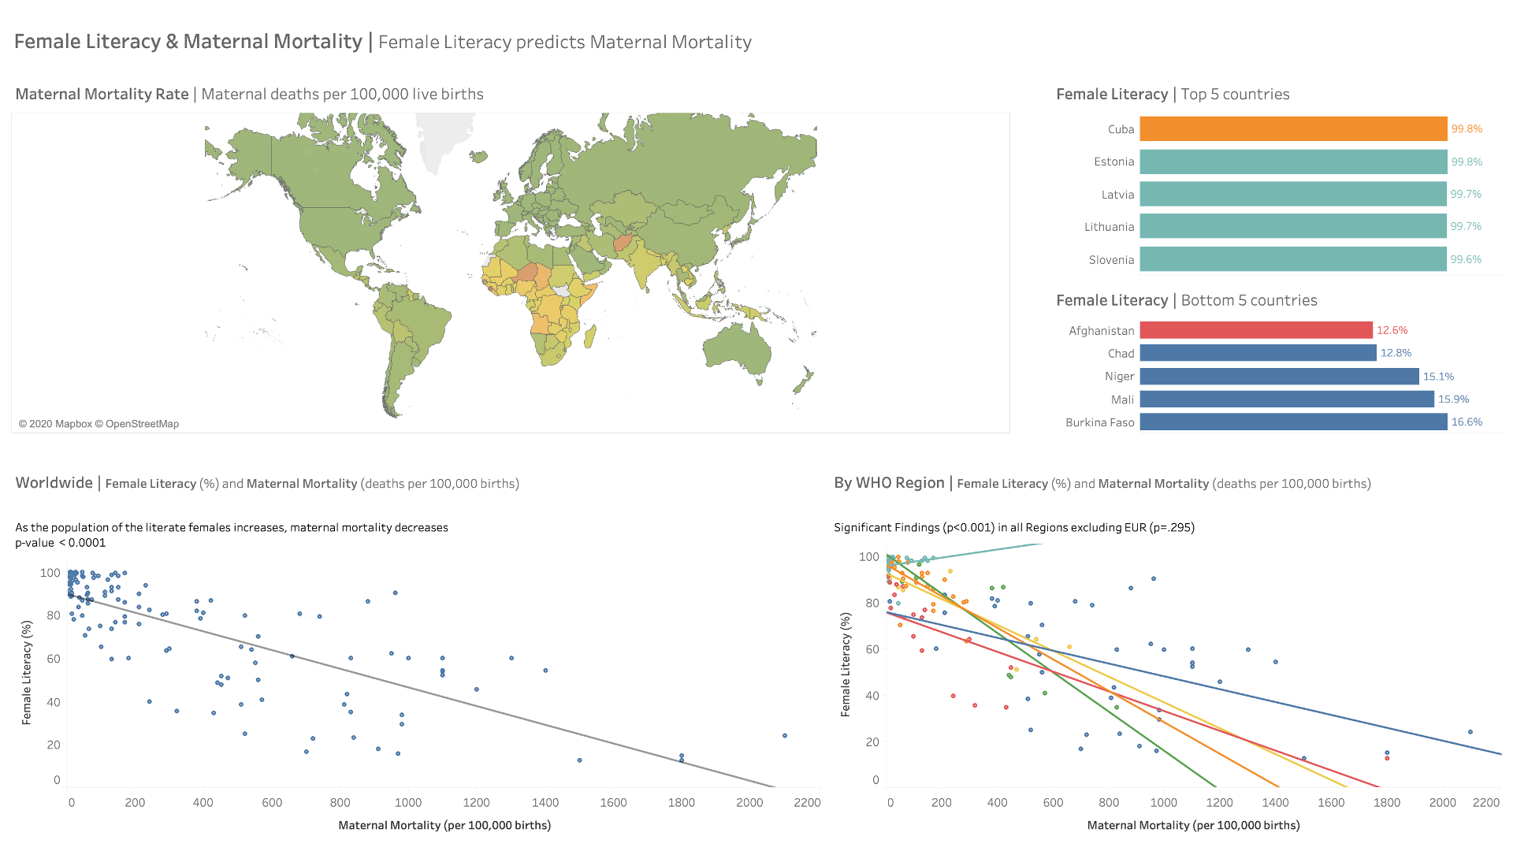

Slide 13
Summary of Findings
Life expectancy and maternal mortality are strongly correlated (correlation coefficient=-.87)
Poverty and Life Expectancy
Strong negative correlation (correlation coefficient=-.68)
For every 1% decrease in the population below the poverty line, there is .3 year increase in life expectancy (p<.001, Rsquared=0.47)
3. Female literacy rate is not correlated with the % of females in the labor force
Adult Literacy and Maternal Mortality Rate
Strong negative correlation (correlation coefficient=-.77)
For every 1% increase in adult literacy, there is a .16 decrease in maternal mortality (p<.001, Rsquared=0.59)
No correlation between democracy score and literacy

Slide 14
Conclusions
Globally, range of data across WHO regions can be stark (ie. AFR vs. EUR)
Addressing poverty and literacy is important for improving the life expectancy and reducing maternal mortality rate
Lessons Learned
Case sensitivity in Python
Variable names without spaces needed
Need to remove NaN values for linear regressions
Tableau can visualize and report p values etc. for linear regressions

